Slide 1
COLLEGE LIBRARY MANAGEMENT SYSTEM
PRESENTED BY
Monowara Tabassum Maisha
20101001
Jarin Tasnim Raya
20101002

Slide 2
Project name and Details
NAME | College Library Management System
ABSTRACT | College Library Management System ER Diagram depicts the relationship between various entities. It can be thought of as a blueprint for your system (project) structure.
DIAGRAM | ER Diagram also known as Entity Relationship Diagram
USERS | College Librarian, College Students (Book Borrowers), and College Admin

Slide 3

Description
This College library management system was made based on college requirements. The system can register book information. Librarian has easy access to each book, search tabs for reliable, secure, and faster monitoring of books and more importantly a report and evaluation papers can be generated in well-organized and well-presented reports.

Slide 4
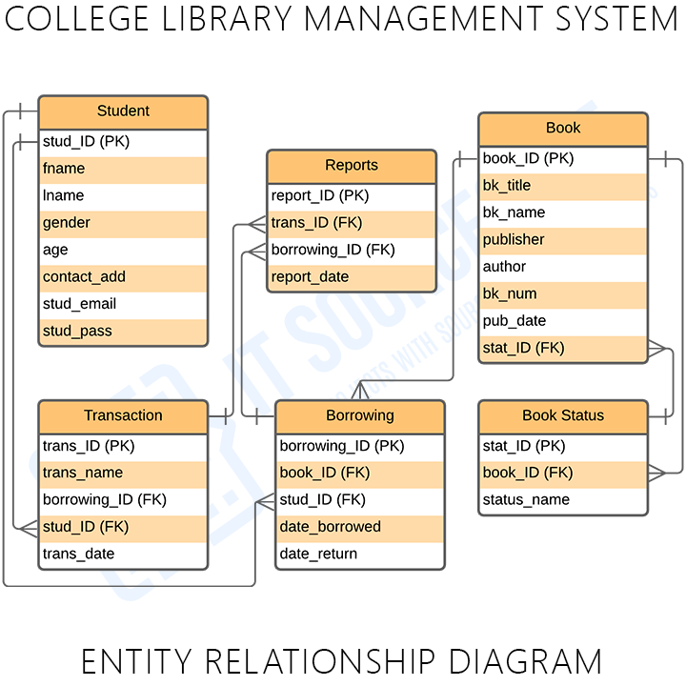
ER DIAGRAM
The College Library Management System ER Diagram is referred as the software database design. This ER Diagram is the graphical depiction of relationships between all the entities involved in the system. Its major components are Entities, Attributes, and Relationships.

Slide 5
ER Diagram for Library Management System with Tables
These tables below provide the complete database tables details such as
Attribute Name, Contents, data types, and length.

Slide 6
Table Name : Student
Attribute Name | Contents | Data type | Length
stud_ID (PK) | Student ID | Int | 15
f_name | Student first name | Varchar | 25
l_name | Student last name | Varchar | 25
gender | Student gender | Varchar | 10
age | Student age | Int | 5
contact_add | Contact address | Varchar | 255
stud_email | Student email | Varchar | 255

Slide 7
Table Name : Book
Attribute Name | Contents | Data type | Length
bk_ID(PK) | Book ID | Int | 15
bk_title | Book Titel | Varchar | 50
publiser | Publiser | varchar | 50
author | Author | Varchar | 50
bk_number | Book Number | Int | 15
pub_date | Publish date | date

Slide 8
Table name : Borrowing
Attribute Name | Contents | Data type | Length
borrow_ID(PK) | Borrowing ID | Int | 15
book_ID(FK) | Book ID | Int | 15
stud_ID(FK) | Student ID | Int | 15
date_borrowed | Borrowing Date | Date
date_return | Returning Date | Date

Slide 9
Table Name : Transaction
Attribute Name | Contents | Data type | Length
trans_ID (PK) | Transaction ID | Int | 15
trans_name | Transaction name | Varchar | 25
borrow_ID(FK) | Borrowing ID | Int | 15
stud_ID(FK) | Student ID | Int | 15
trans_date | Date of transaction | date

Slide 10
Table Name : Reports
Attribute Name | Contents | Data type | Length
report_ID (PK) | Report ID | Int | 15
trans_ID(FK) | Transaction ID | Int | 15
borrow_ID(FK) | Borrowing ID | Int | 15
report_date | Report date | Date

Slide 11
Table Name : Book status
Attribute Name | Contents | Data type | Length
stat_ID(PK) | Status ID | Int | 15
book_ID(FK) | Book ID | Int | 15
status_name | Status name | varchar | 25

Slide 12
Thank You

